Slide 1

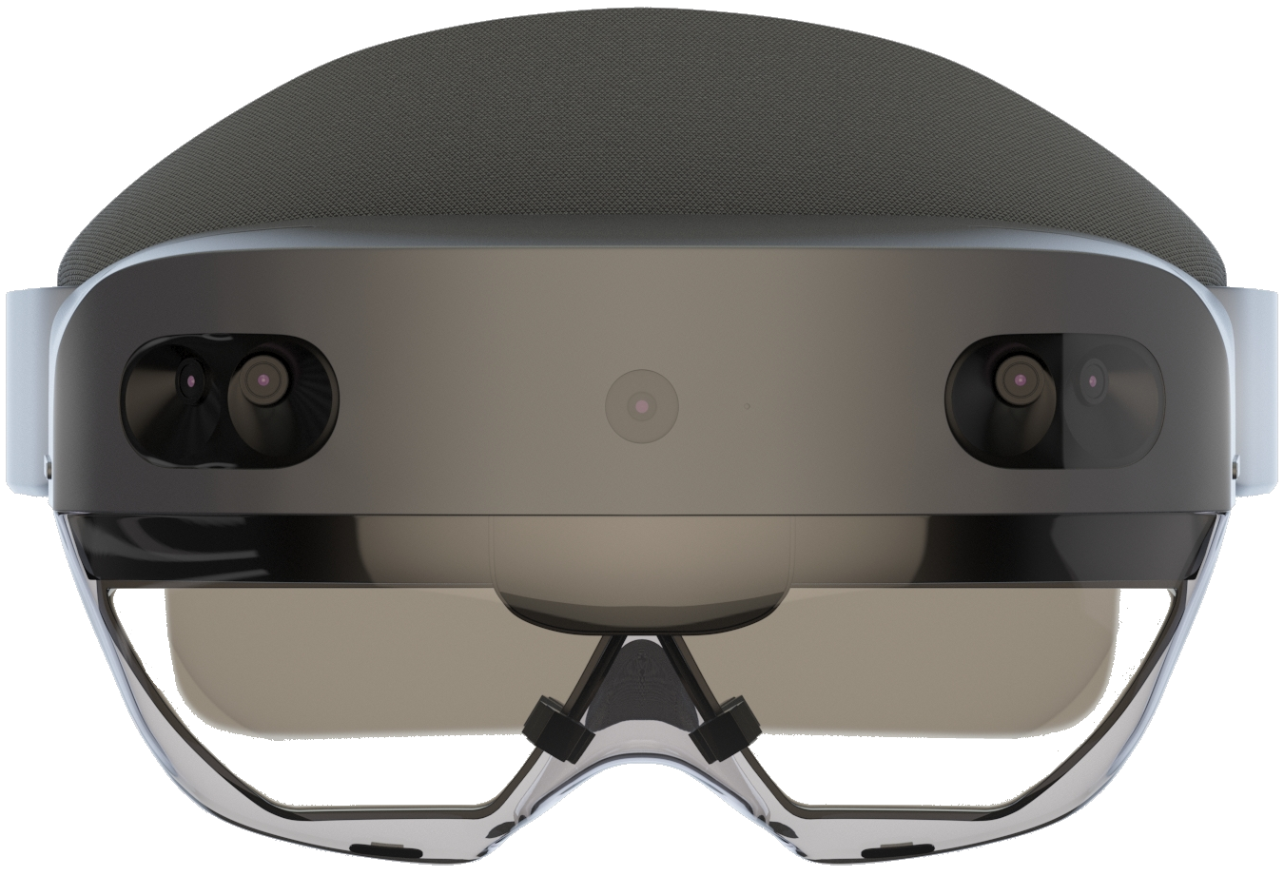

Joost van Schaik
Introduction to development for HoloLens 2 with Mixed Reality Toolkit 2

Slide 2

Just to be absolutely clear

Slide 3


Obligatory vanity slide
Joost van Schaik
Architect (Developer++)
Microsoft MVP (WinDev & Insider)
Aka LocalJoost, aka HoloJoost
(in)’famous’ as blogger
(as of recently interplanetary ☺)
LinkedIn 🔊, Twitter 🔊🔊🔊🔊,
27 years development
Background GIS
3 year → 1 year → ☺

Slide 4
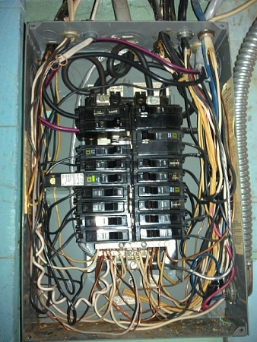
Topics
Why talk about MRTK2 now?
Why IS there an MRTK2?
Installation & setup
Configuration
Profiles
Services (dependency injection!)
Some interaction
Including some demos 😱
Notes:
TextMesh Pro?
IL2CPP
Unity baseline
Where are the buttons?

Slide 5

Yeah dude… why talk about it now?
MRKT2 works on HoloLens 1 too
…and Mixed Reality headsets
MRTK1 in ‘maintenance mode’
Preparation = 🔑
😃😎

Slide 6
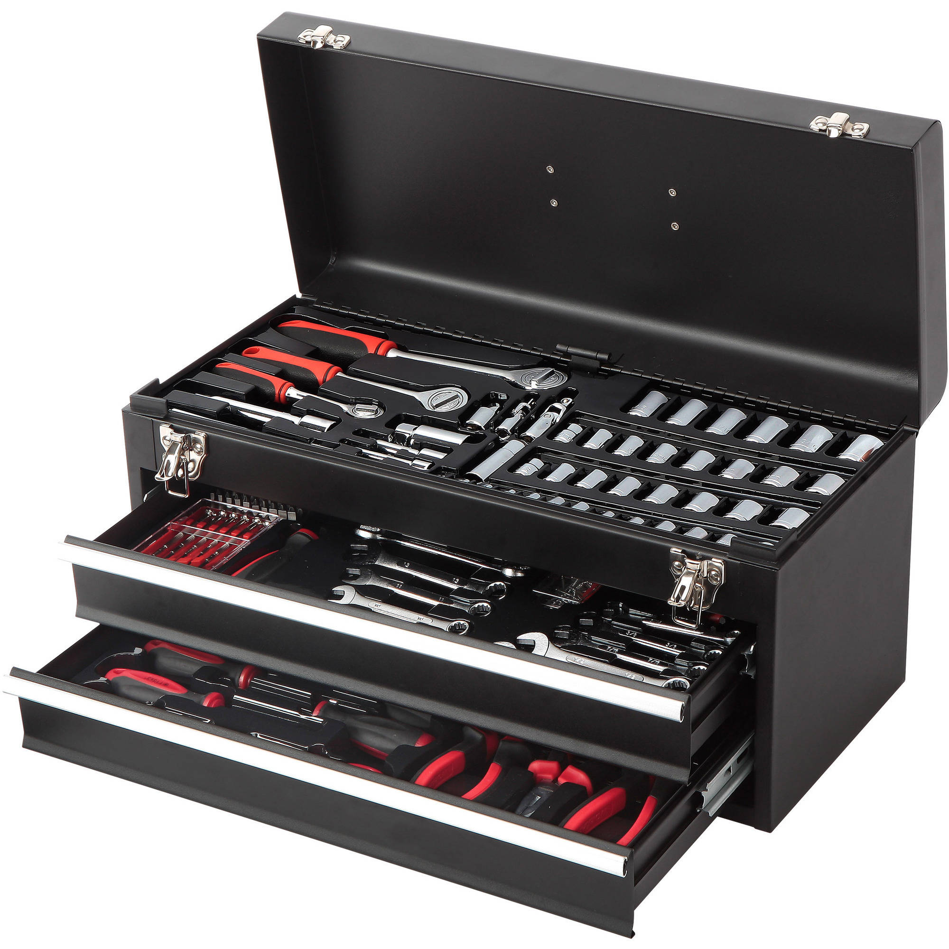
Why is there an MRKT2?
New HoloLens 2 interaction models
Cross Platform
Extendable model
Lessons learned from MRTK1
Centralized configuration
Dependency injection (singletons)
More drag, drop & configure, less code

Slide 7
Caveat emptor
Cross platform = OpenVR
Configuration complex
‘Simple standard scripts’ hard to configure and connect
Trouble in paradise (XRTK)

Slide 8
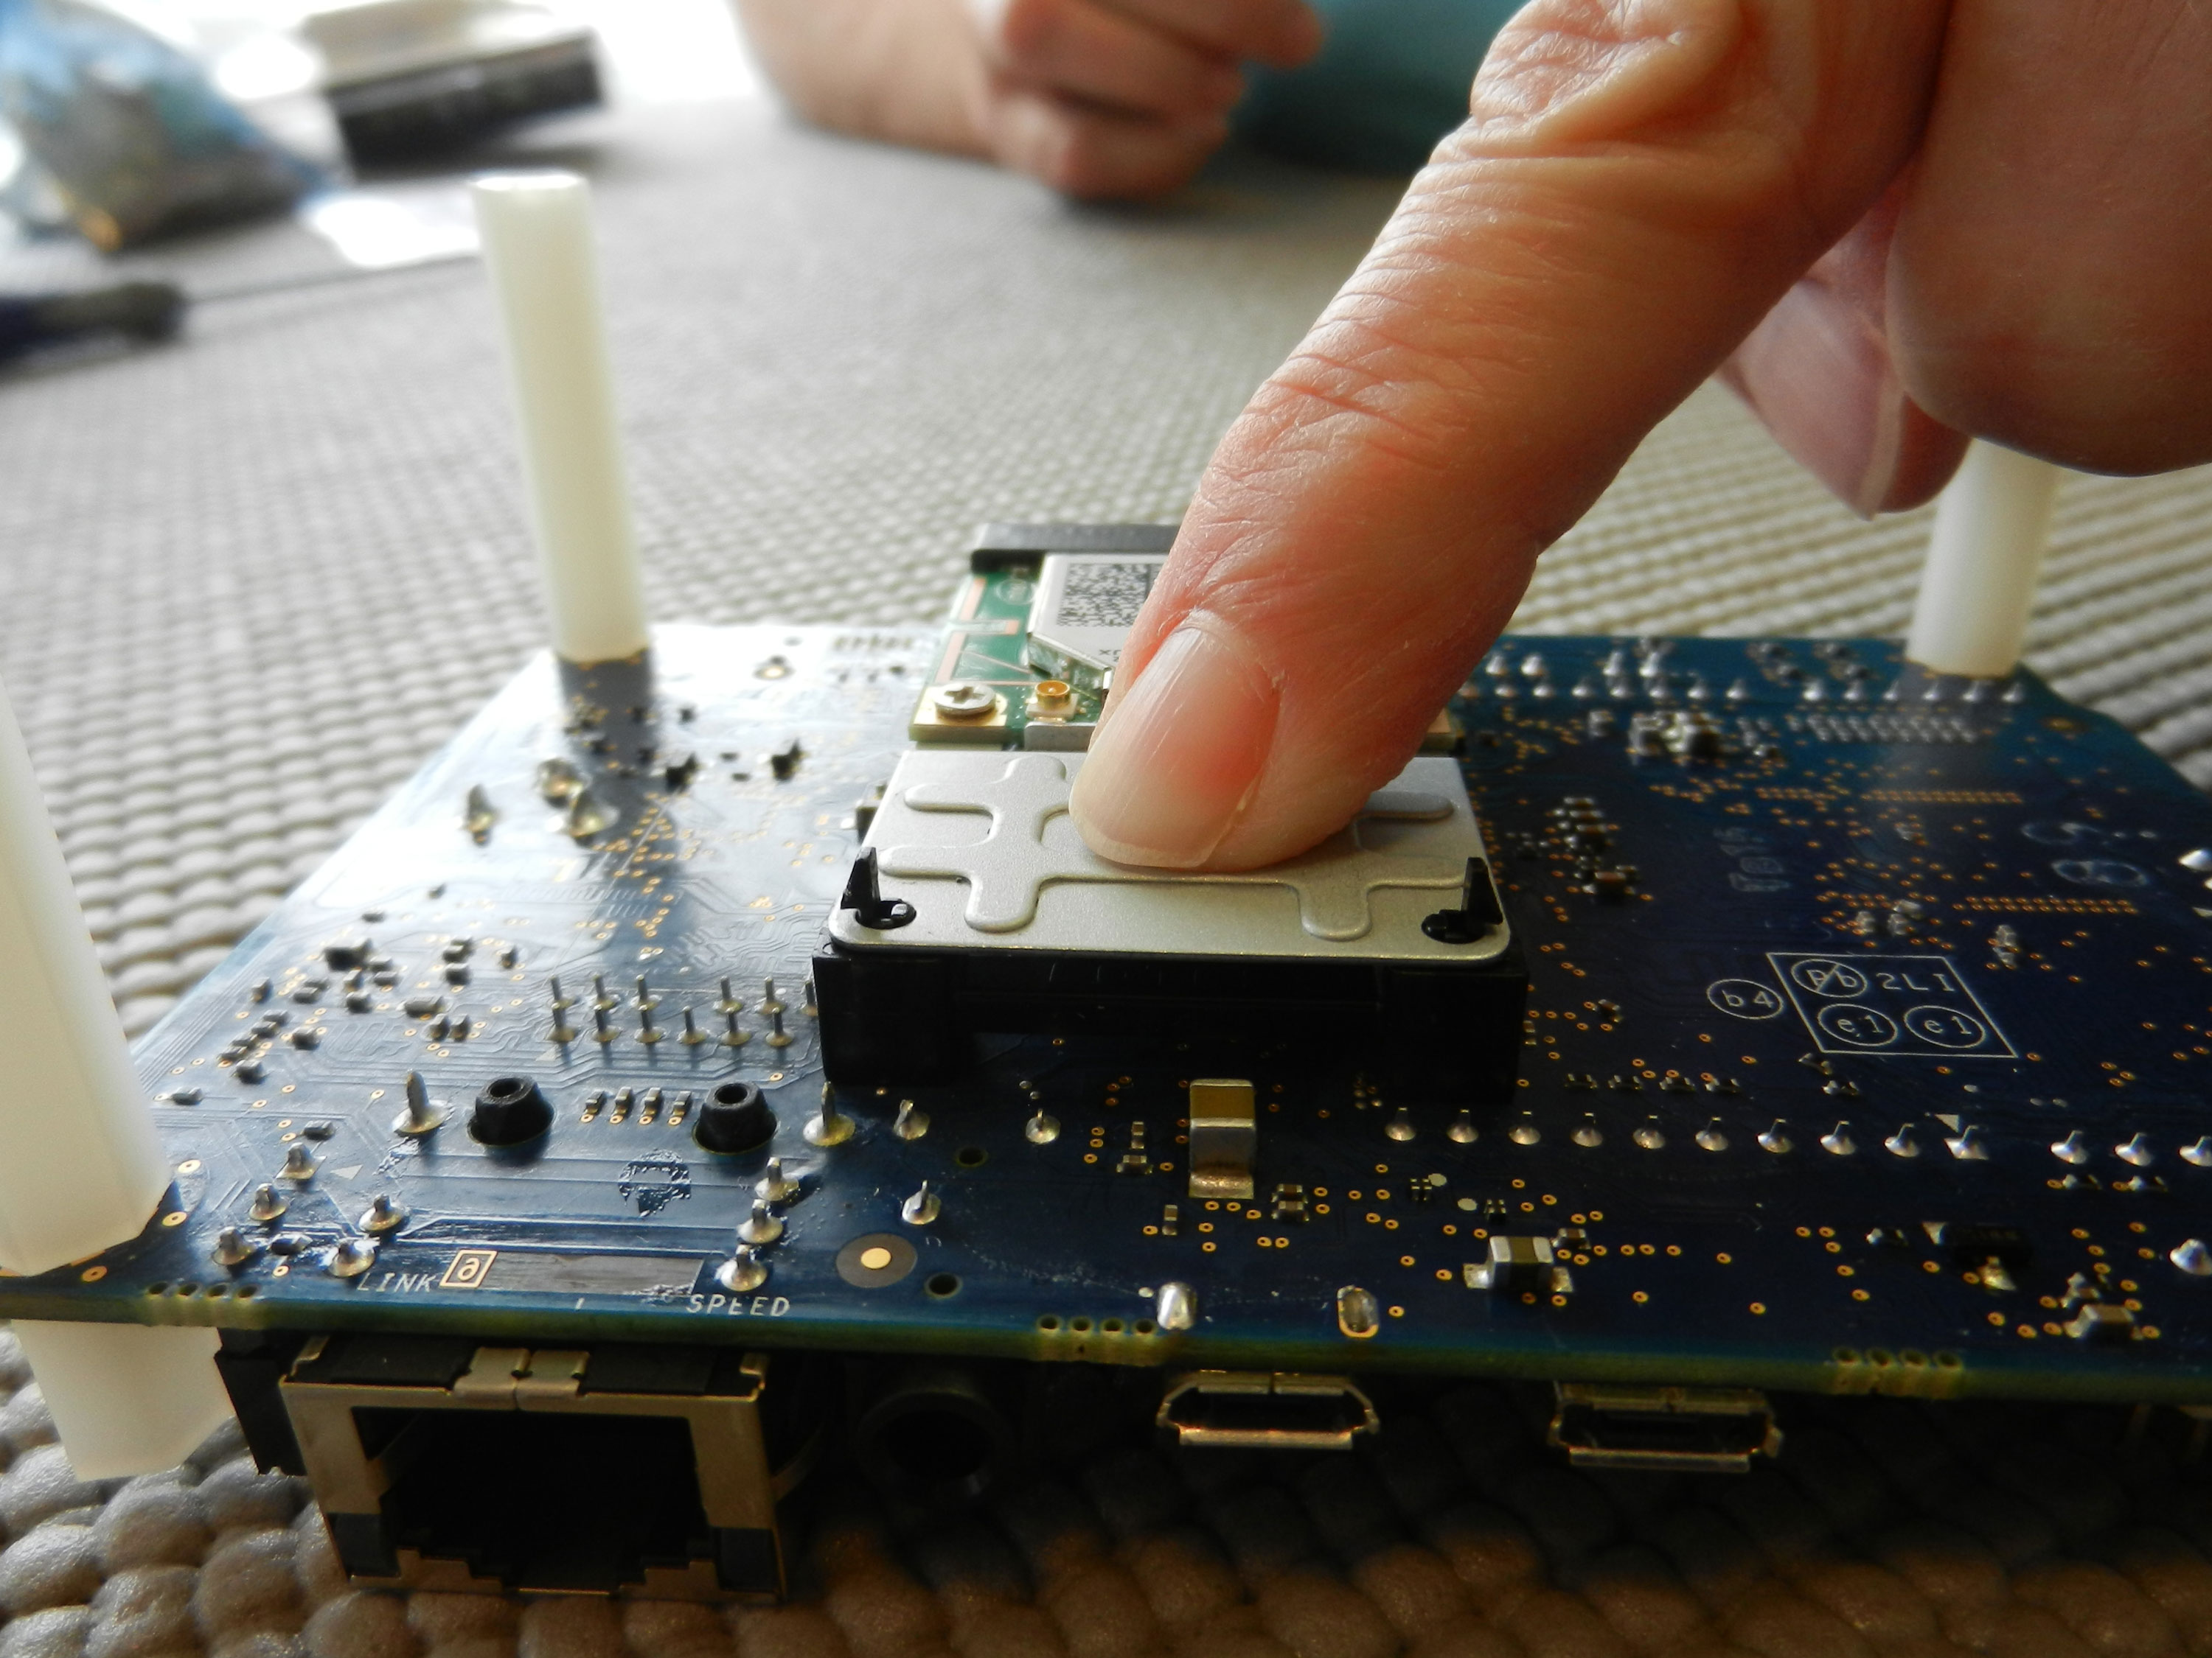
Install and setup
Shopping list
Unity 2018.4.x (LTS)
Visual Studio 2017 / 2019
Window SDK 18362
HoloLens 2 emulator
Windows 1903
Windows 1903
Notes:
Unity baseline 2018.4.0 (LTS)
Copy into assets and wait

Slide 9
Install and setup
https://github.com/Microsoft/ MixedRealityToolkit-Unity
mrtk-release (mrtk-development for the brave)
Notes:
Unity baseline 2018.4.0 (LTS)
Copy into assets and wait

Slide 10
Install and setup
Folders:
MixedRealityToolkit
MixedRealityToolkit.Providers
MixedRealityToolkit.SDK
MixedRealityToolkit.Services
MixedRealityToolkit.Examples optional
ExtensionTemplates – in root
Notes:
Unity baseline 2018.4.0 (LTS)
Copy into assets and wait

Slide 11
Install and setup
Mixed Reality Toolkit / Add to Scene and Configure
Window / Text Mesh Pro / Import TMP Essential Resources
File / Build Settings / UWP Switch Platform
Notes:
Unity baseline 2018.4.0 (LTS)

Slide 12


Aside - IL2CPP
In Unity 2018.x .NET backend deprecated
In 2019.x gone
Unity C# → C++ (still UWP)
Notes:
C# => C++

Slide 13

Configuration
Default profiles
Clone, adapt
Reusable
Expandable
Always at the same place
Gets rid of Singletons (bar one)
Using… drumroll… dependency injection!

Slide 14

Configuration - a demo is worth a 1000 words
Notes:
9:00

Slide 15
Configuration – summary
Clone, adapt
Only one singleton left
Using services – easy
Creating extension services – little less easy
Huge tree of configuration
Intimidating
Feels over engineered
Notes:
16:00

Slide 16
Configuration – summary
MRKT is
5 folders (examples are optional)
ExtensionTemplates – in root, not Assets)

Slide 17
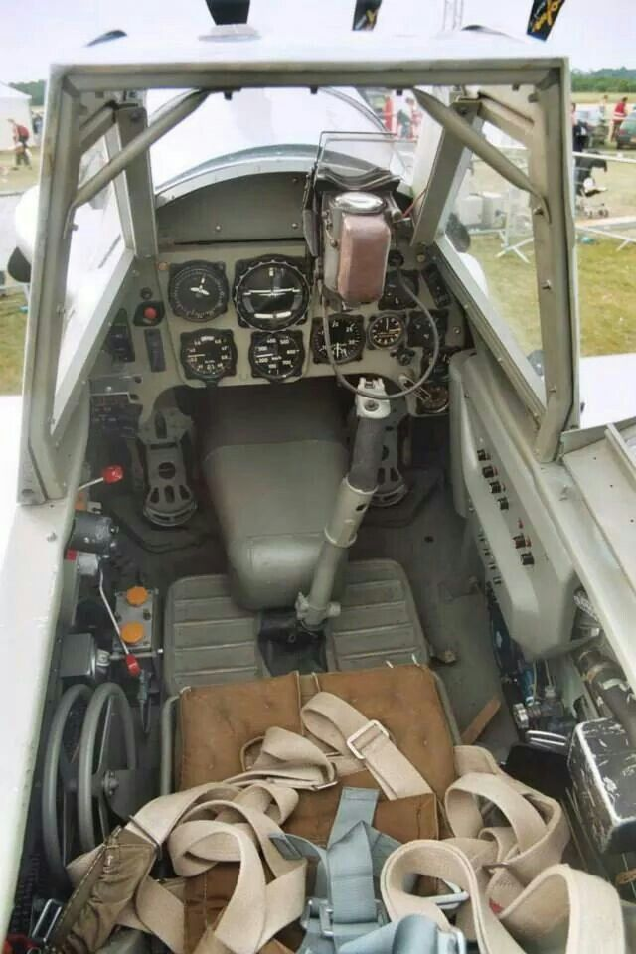
Interaction - MRTK1
It used to be so simple
Implement IInputClickHandler
…and/or IManipulationHandler
And you were basically done
Notes:
Unity baseline 2018.4.0 (LTS)

Slide 18
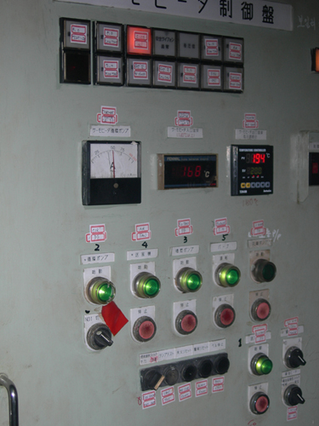
Interaction MRTK1
But then again…
We could only air tap and drag
Now… we can touch. And grab… and…

Slide 19
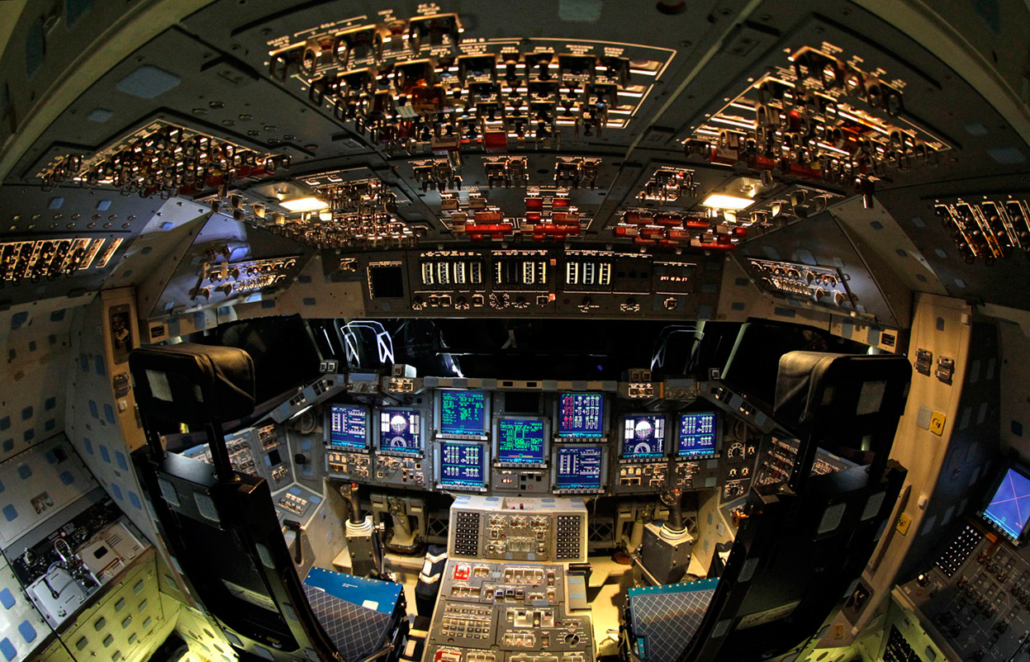
Interaction MRTK2
Tap using a ‘hand ray’
Take care of touch as well
… and then what?
Grabbing

Slide 20
Interaction MRTK2
DYI tap, touch & focus
IMixedRealityPointerHandler
IMixedRealityTouchHandler
IMixedRealityFocusHandler
Notes:
Unity baseline 2018.4.0 (LTS)

Slide 21
Interaction MRTK2
Using MRTK components:
Interactable
Near Interaction Touchable
Configure NIT to pass touch TO Interactable as
Touch
Click
Notes:
Unity baseline 2018.4.0 (LTS)

Slide 22

U can touch this (& focus) demo
Notes:
19

Slide 23
Interaction MRTK2
Using MRTK components:
Interactable
Near Interaction Touchable
Configure NIT to pass touch TO Interactable as
Touch
Click
Notes:
26

Slide 24
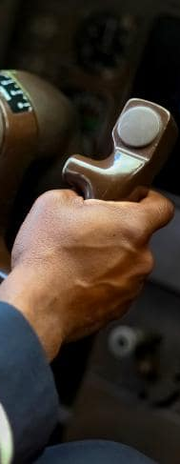
Interaction MRTK2 - Grabbing
Using MRTK components:
ManipulationHandler
Near Interaction GRABBABLE
Sometimes it’s just too easy ☺
Notes:
Unity baseline 2018.4.0 (LTS)

Slide 25
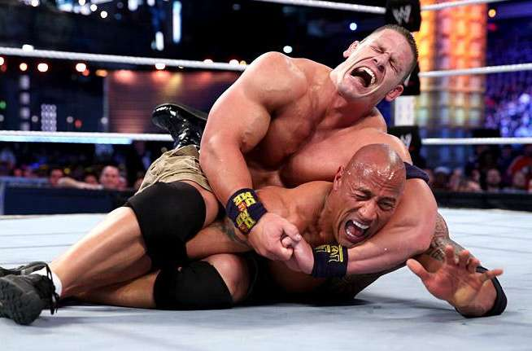
Grabbing demo

Slide 26

MRKT2 – preliminary verdict
Clever
Very useful
Works on HL1, 2, WMR, Steam
Much more complex to get started
Feels overengineered
… but very much usable

Slide 27
Lessons learned / insights gained
IInputClickHandler & IManipulationHandler → IMixedRealityPointerHandler
Losing Singleton is hard
Migrating breaks a lot.

Slide 28
Lessons learned / insights gained
HoloToolkitCompatiblityPack (also includes missing fonts and 3DTextPrefab)
But seriously…
Get rid of Singleton game objects. Bad pattern.
In HTKCP only for migration purposes

Slide 29
Lessons learned / insights gained
Apps for HL1 👍
Still ‘fluid’
Don’t know half yet
Hard to test app without device
Easier with the new HL2 emulator
CPU hungry
IL2CPP … meh
Notes:
IL2CPP – learn to develop in editor!

Slide 30

Emulator demo (if time permits)

Slide 31

Important links
MRTK2 https://github.com/Microsoft/ MixedRealityToolkit-Unity
Mixed Reality Installation Checklist https://docs.microsoft.com/ en-us/windows/mixed-reality/install-the-tools
Dong Yoon Park’s migration guide https://bit.ly/31pDSUM
My blog ☺ http://dotnetbyexample.blogspot.com

Slide 32

What I DIDN’T talk about
IL2CPP
Debugging
Migration issues
All the beautiful new prefabs
…and probably more

Slide 33


That’s all folks

Slide 34

joost.van.schaik@wortell.nl
joost.van.schaik@outlook.com
@localjoost
http://www.linkedin.com/in/joostvanschaik
http://dotnetbyexample.blogspot.com/

